Slide 1
School Information System
Group Project
Develop a console application using C++ in collaboration with your peers forming a team.
Alex Legner, Alex Craig, Jone Salauneune and Ritika Ritika

Slide 2
Client Needs
Add new staff records/edit
Add new student/edit
Attendance management
Faculty management
Student record management (Student Information)
Create edit and update school notices
User Needs
View academic results
View School Notices
Sign Up Parent

Slide 3


Target Audience
Lydia is a teacher at Upper Hutt College who teachers English101.
As a teacher, Lydia wants to empower her students to better by appreciating the English language and its beauty.
Instead of doing admin duties, she prefers to use that time to better help her students.
John is a student at Hutt Valley High School who studies Math101
As a student, John requires quick and easy access to his report cards to work and improve on his studies and get feedback from his tutors.
Time is his greatest problem as he would rather study than spend time messing around with his report card.
A bonus would be easy access for his parents so they could check up on his work without having to contact John directly, saving extra time and work.

Slide 4
Assumptions
Assumptions (Users):
All users will understand English
All users know how to type on a keyboard
All users would push enter after putting in text
Assumptions (Console Applications):
Users would push ‘enter’ or ‘return’ when using the application without instruction to do so.
Users will type help when they are unsure what to do.
Exit will typically exit the application
Help will show a help menu
Back will go back to the previous menu
Options are easier to select when they are numbered for input, i.e., 1 for start.

Slide 5
Research - Collaboration
Trello - the visual tool that empowers your team to manage any type of project, workflow, or task tracking. Add files, checklists, or even automation.
Click Up - Click up is a large-scale task manager for large companies to allow workers to see tasks and organize them as needed.
Monday.com - Workflow software which allows you to manage tasks within a team and manage a timeline.
Notes:
We picked Trello because it is free to use and collaborate with our small team and was simple to use / understand. It will make organizing the workflow of the project easy because everyone in our group already knows how to use Trello.

Slide 6
Research – Technical Options
C++ - is a general-purpose language used in systems, GUIs, and embedded software.
C# - is an object-oriented, modern language
Java - Java is an object-oriented, and multi-platform language
Python - Python language used to make websites, software, automate tasks, and data analysis
Notes:
We picked C++ because that is a language our entire team is comfortable with. It is one we are learning and know we can all code in whereas we haven’t all tried other languages. Picking one we all knew is a good option as we need to be able to work together.

Slide 7
Research – IDE Options
Visual Studio Code - VSC is one of the most popular free open-source code editors by Microsoft. Provides many extensions including C++.
Code::Blocks - is an open-source and free IDE for C and C++ used on multiple platforms and build in C++ using a GUI widget tool called wxWidget.
CLion - CLion is a modern IDE by JetBrains which is designed to run C and C++ on various platforms like Windows, Linux, and macOS.
Visual Studio 2019 - Visual Studio is the most popular choice for good reasons: an impressive collection of available Visual Studio extensions. likely the most popular C++ IDE for Windows.
Notes:
We picked Visual Studio 2019 because for the majority of course our group has learnt and studied solely using Visual studio code, due to this and the ease of which the IDE works with console applications makes it a simple and perfect choice for this assignment.

Slide 8
Research – Version Control
CVS - Concurrent Versioning System, is a free client-server revision control system in the field of software
SVN - SVN is a free and open-source software as an alternative to CVS that is aimed to be more reliable and bug free.
GitHub or git - GitHub is a code hosting platform for version control and collaboration. let's you and others work together on projects.
Microsoft Teams Files - Microsoft Teams is cloud-based team collaboration software that includes messaging, calling, video meetings and file sharing.
Notes:
We picked GitHub because our team is most familiar with the operations and merging system implemented by this website/application. The ability to look back through an individual's work and adjust each other's code with branches and eventually merging, singles GitHub out for its simplicity and group collaboration. GitHub fits well for the team as it also links well with our choice of IDE VS 2019.

Slide 9

File Management
Git will allow for file collaboration, but any
Coding related files should be in the coding folder and all other files in the main directory:

Slide 10
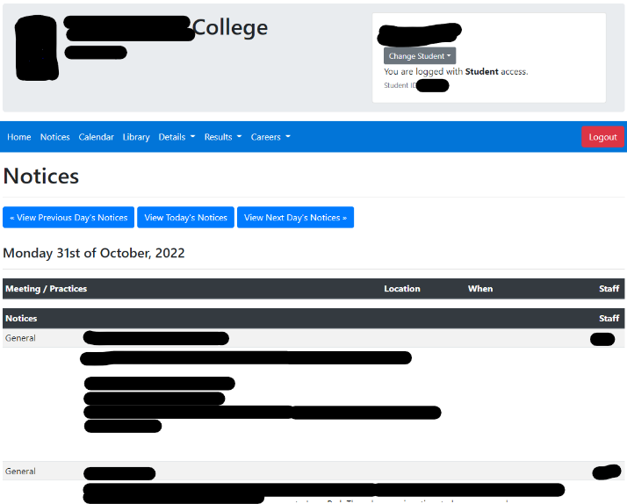
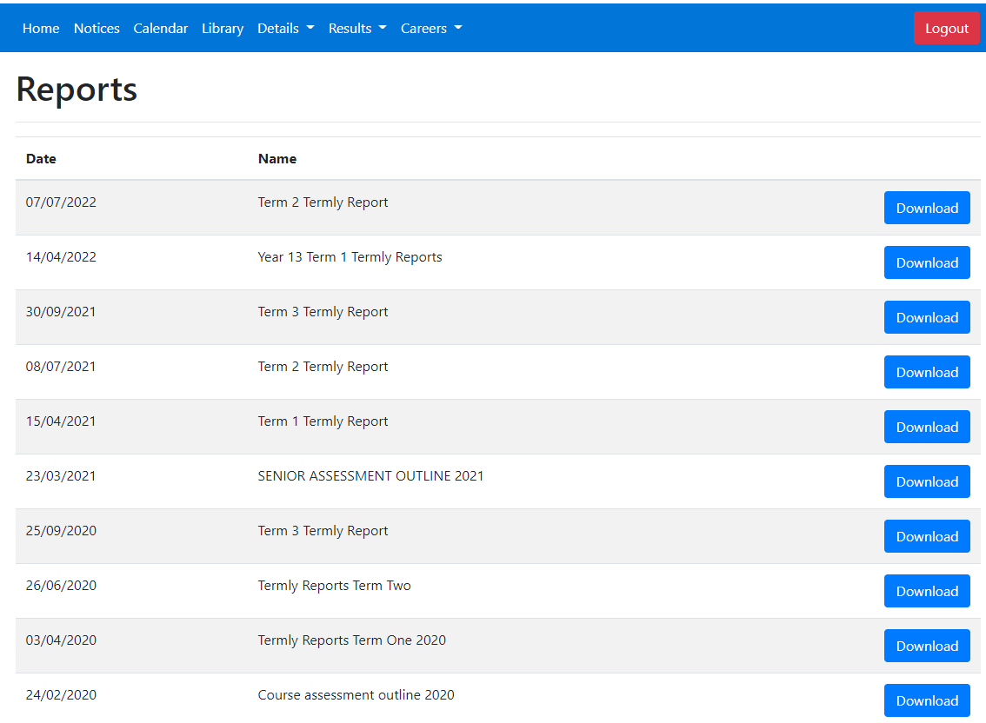
Research - Swot Analysis - Kamar
Strengths | Easy to read Menu Bar. Reports list is easy to read and easy to use -> download the report you want. Login/Logout simple with a timeout feature.
Weakness’ | Some links don’t work -> library not setup properly and still showing, notices don’t show ALL notices, only some of them.
Opportunities | Few competitions for this type of software. Kamar is widely used in NZ. Include tutorials on how to use, with feature to never show again.
Threats | No clear instructions on how to use KAMAR, you must learn your way around to find what you are looking for.

Slide 11
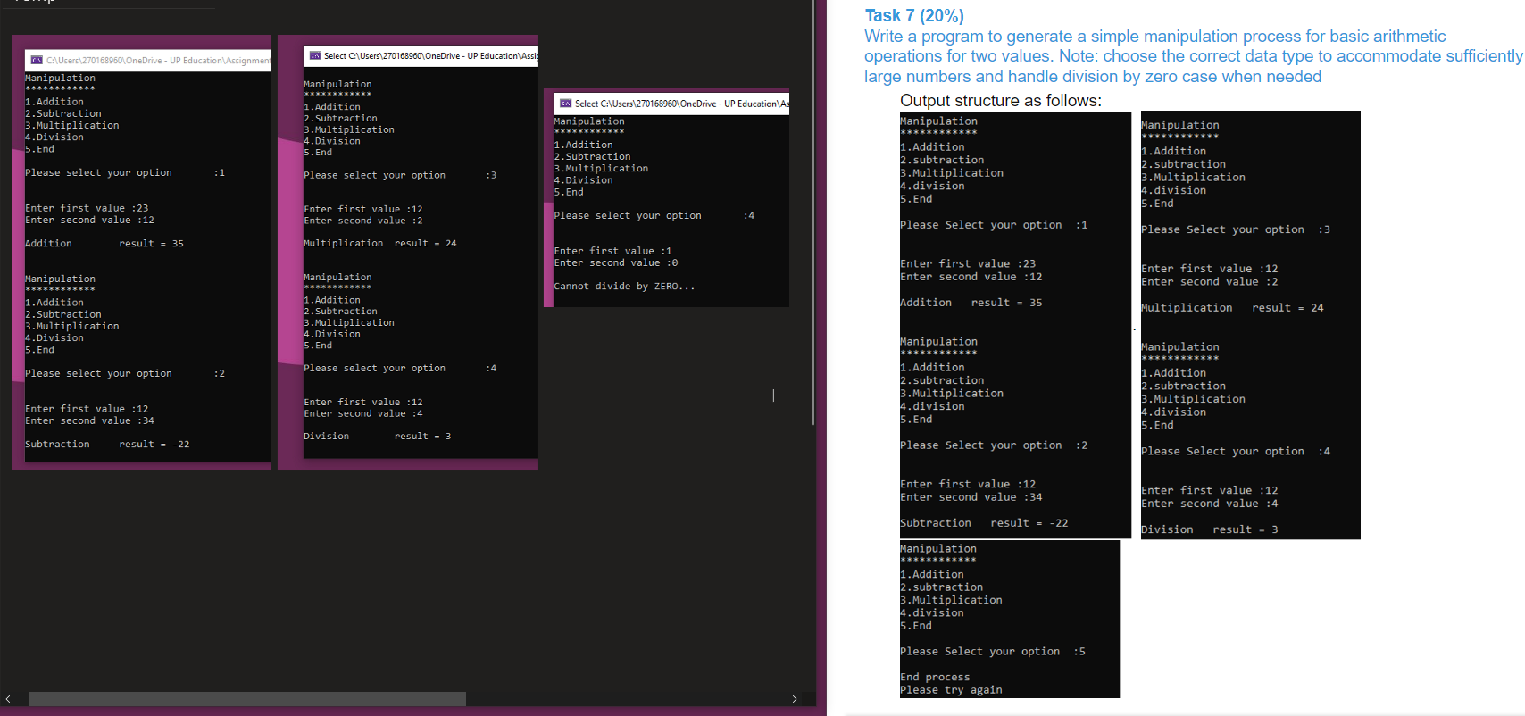
Research - Swot Analysis – Console App (calculator)
The information provided is clear and concise, focuses on information and selection of data, little to no clutter of unneeded information. Spacing horizontally is easy to follow with like information next each other and unlike separated.
Some of the spacing across is not even and hard to follow
Could allow in line operations i.e., 1 x 2 instead of selecting option 3 and entering 1, 2.
Console is very restrictive, can’t push buttons like a normal calculator.

Slide 12
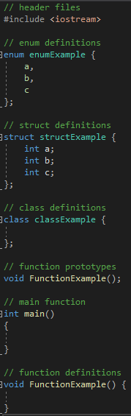
Code – Style Guide
Naming Convention
Function names will follow the camelCase naming convention. -> camelCase
Local variables will follow the camelCase naming convention. -> camelCase
Const variables will be SNAKE_CASE to show their difference. -> SNAKE_CASE
Notes:
Static and Global Variables There will be no global variables within any files to prevent naming conflicts. All variables will need to be accessed either as a parameter or pointer.
Overloading
will start with the least parameters and underneath follow least to most parameters. Each overload must have a comment to define its purpose even if it’s the same.

Slide 13

Code layout:
From top to button follow-> C++ headers, enum definition, struct definition, class definition, function prototypes, main function, function prototypes definitions.
Using
Using namespace std is bad practice and is not allowed, however, to prevent repetition, you can use using std::member where member is what you are using. For example using std::string allows us to write string instead of std::string everywhere. Using statements are to be put under the header file in preprocessor.

Slide 14
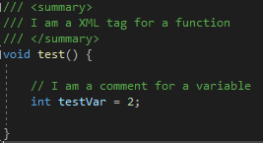
Comments All functions and classes must have ///XML comments Variables can have // comments above or next to it to define what the variable is used for. To summarize code use a // comment above it. Add blank lines in between lines of code that aren’t similar or don’t apply to that content

Slide 15
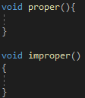
Bracket convention
Use C++style convention with { next to last line and } understand last line as shown in example
Data structures
To store data we will use file loading and saving. File saved which contain data will be csv’s and stored under the naming convention “ _name.csv”. Multiple files are allowed for different types of stored data. Data will be loaded to vector<vector<string>>to store data as if it were in the csv format. Data should not be directly edited/read to/from the file instead using the internal memory and then saved/loaded from memory.

Slide 16
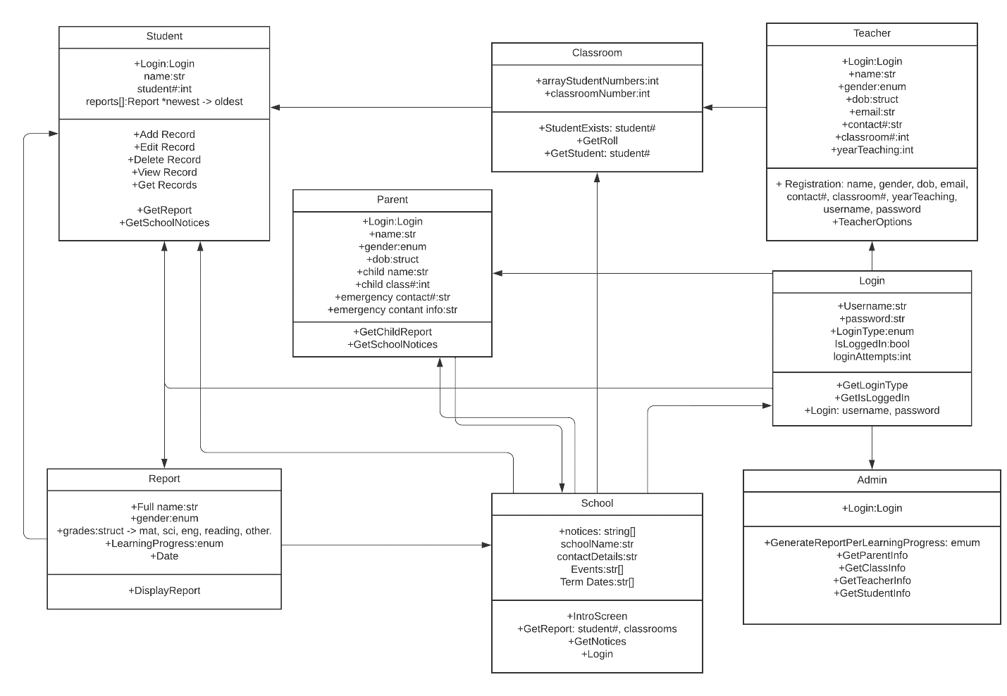
UML Diagram

Slide 17
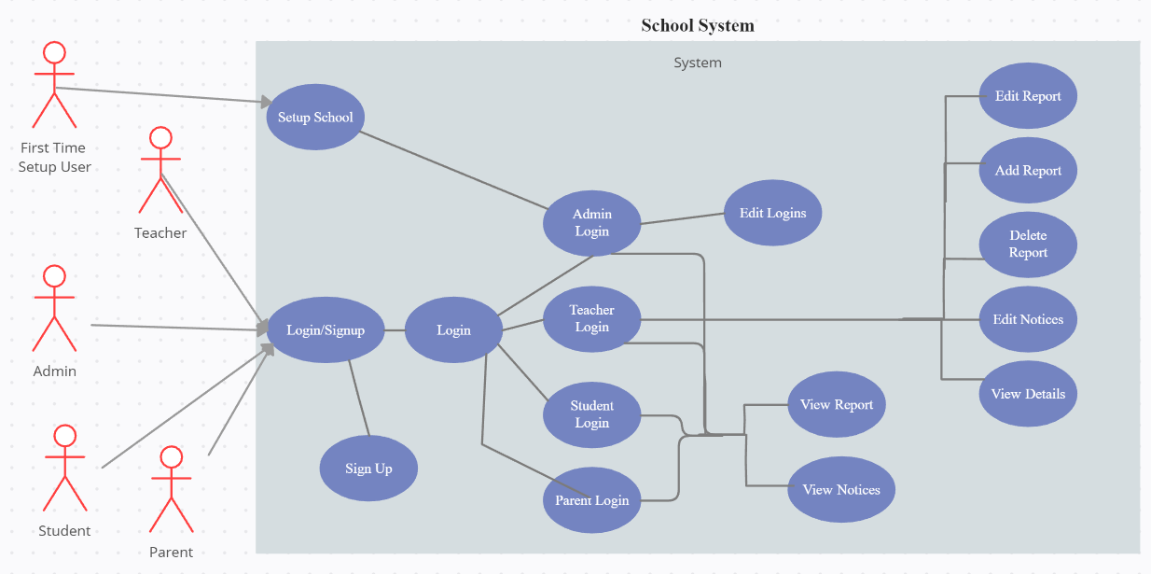
Use Case Diagram
Notes:
The School system will (abstraction)is hiding data from outside its class only showing necessary data to reduce the complexity of the code and increases the readability. This also has the effect of adding a security layer. For example, an admin will be able to access view and edit most of the data in the school system, while a parent or teacher can only view certain data like school notices to student attendance.

Slide 18
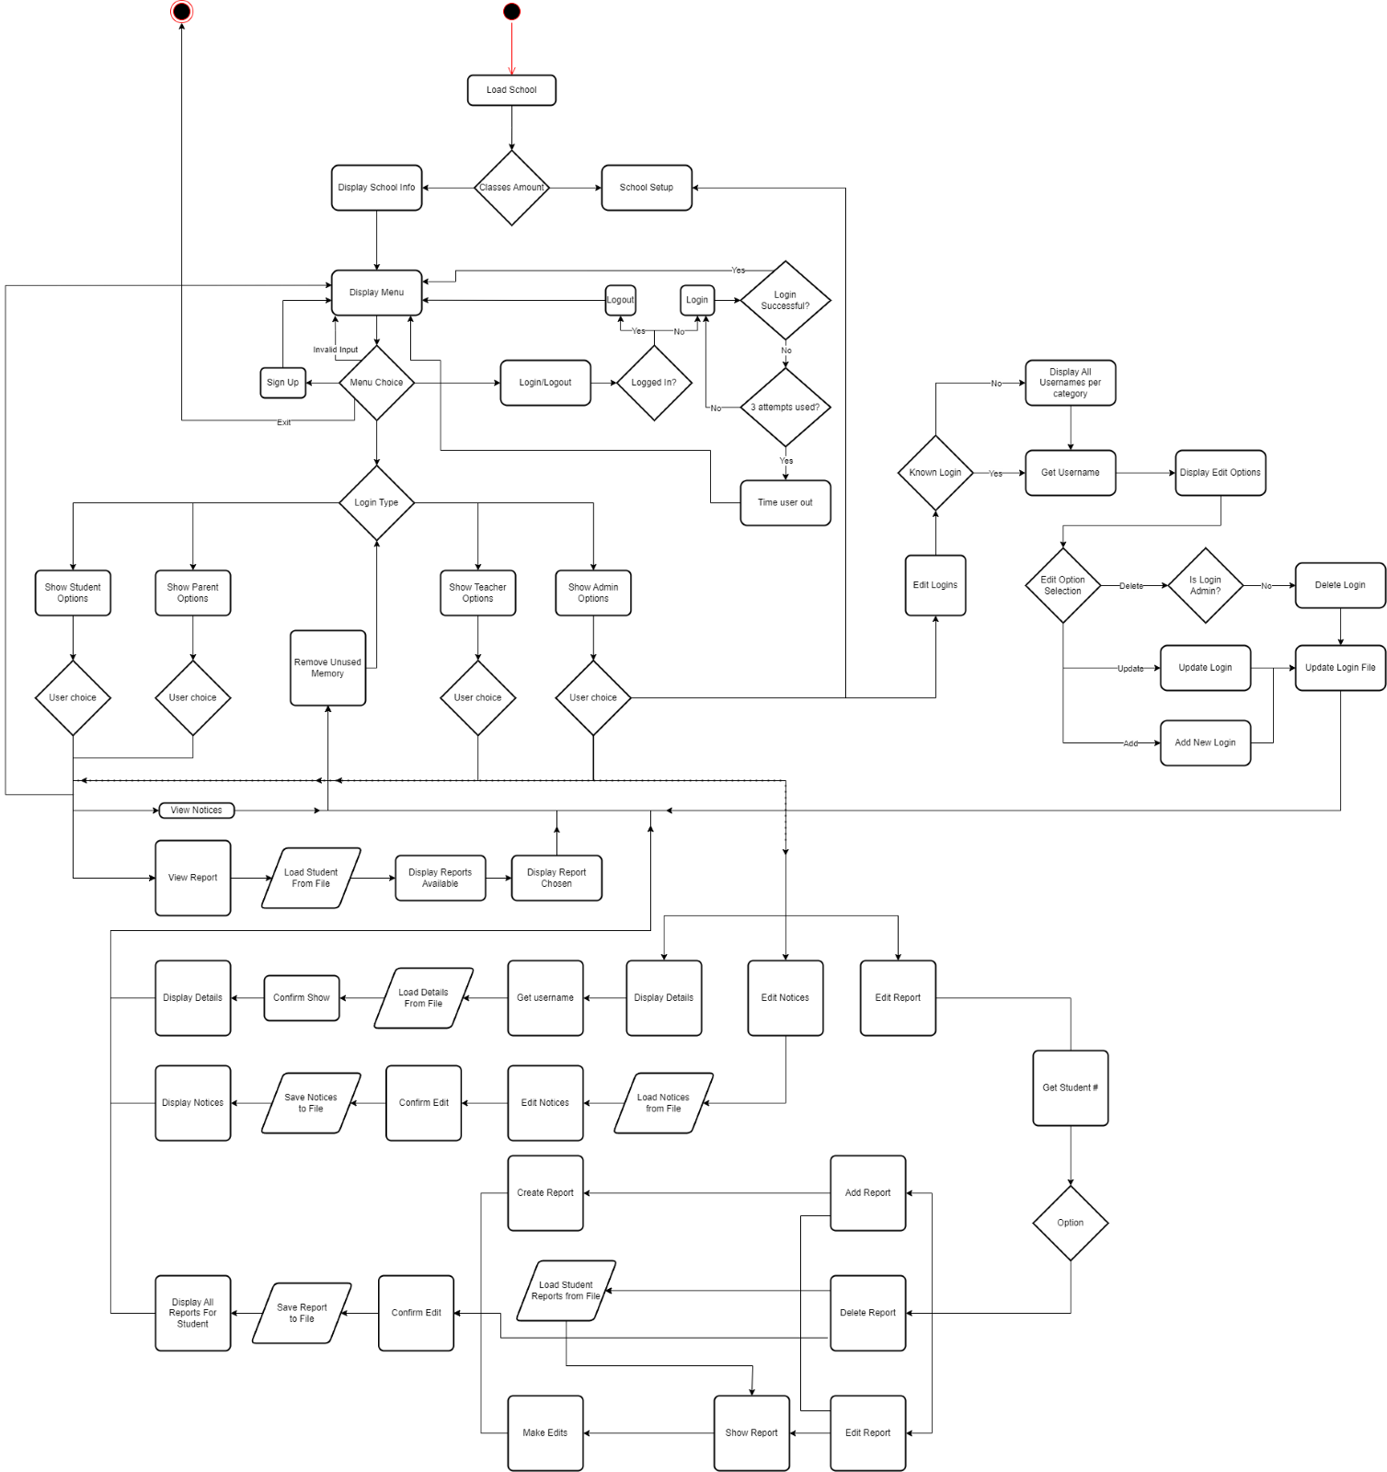
Flow Chart

Slide 19
User Survey Analysis
User 1: "ADMIN TASKS" entering letter for cancel command not preferable, when adding students to classroom confused by Null student error, adding a student to database does not give confirmation, edit function is tiresome having to reinput all the information instead of selection what you want to edit. Would prefer text instead of numbers for selection.
User 2: "TEACHER TASKS" typed in name of student for input instead of corresponding number, 'grade name' is confusing and vague, report section confused user due to gender and grade name selection.
User 3: "PARENT TASKS" parent number was confusing due duplicates, 'Emergency contact' should be direct and say 'Emergency Contact Number.
User 4: "ALL TASKS" unable to decipher selection process (description added at start of program), continued to select exit program after signing up "accidentally".
User 5: "PARENT TASKS" was unsure if he managed to reach the proper report page, found the letter spacing to be well made and selection process easy to understand.

Slide 20
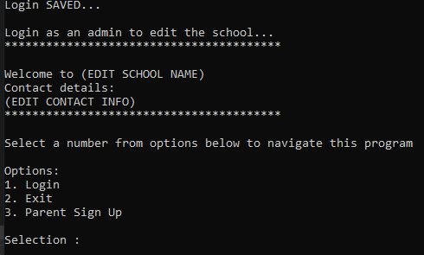
Final Changes to product
Notes:
Upon initial testing we found that users were getting stuck on the first menu, since no instructions were given to them. We put a simple prompt that tells the user to select a number from the options below. We found with this little change users were navigating the program a lot faster.

Slide 21
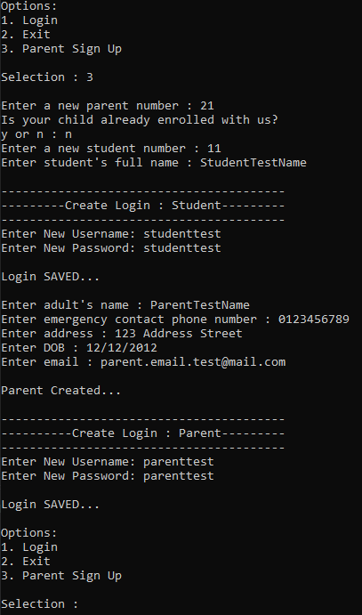
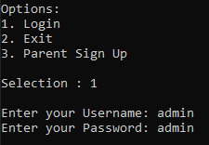
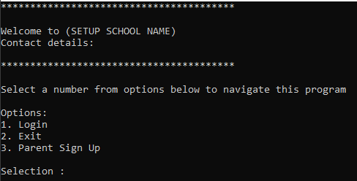
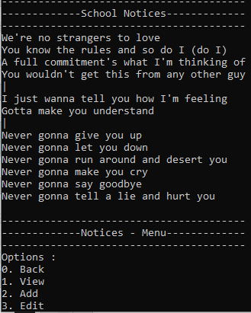

Final Product
Notes:
Top-Left image shows the first main menu that users will see once they have opened the program. Where it says “ Welcome to” is where the school's name and other details will be displayed.
The navigation of the program requires users to enter a number from the options given to go to other menus.
Right top image is for student and parent creation.

